Slide 1






Team 4
Pitch Presentation

Slide 2

OVERVIEW
Pango Blocks is a logic mobile game in 2D single player, in which the player has to choose logic blocks and build the path for Pango and help him to reach various items for his friends.
Overview

Slide 3
DISCOVERY
The main theme of the game is Pango’s curiosity which will lead him all across the globe, trying new foods and seeing new places
Theme

Slide 4



Logic/educative game for mobile devices
5 adventures to discover for your enjoyment
2 difficulty levels
Age Target: Pegi 3+
No stress and no timer
Colorful and fully interactive game
No in-game purchases and no invasive advertising
Main Features

Slide 5



PANGO
Pango is a blue racoon and is the main character of the game.
In the first stage he’s a normal blue racoon, but later he starts travelling around the world wearing a typical tourist outfit.
Help him find new objects!
Characters

Slide 6

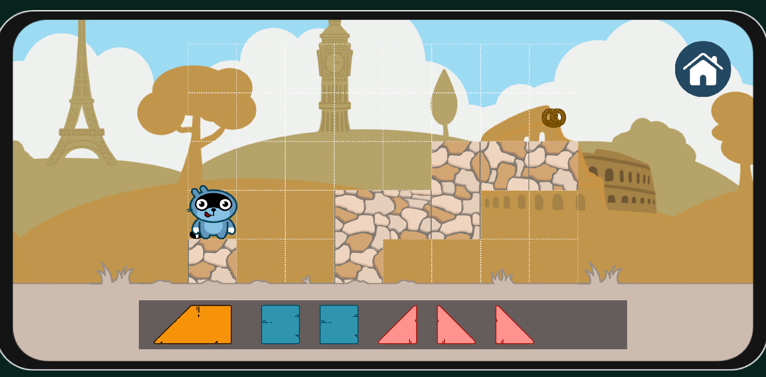

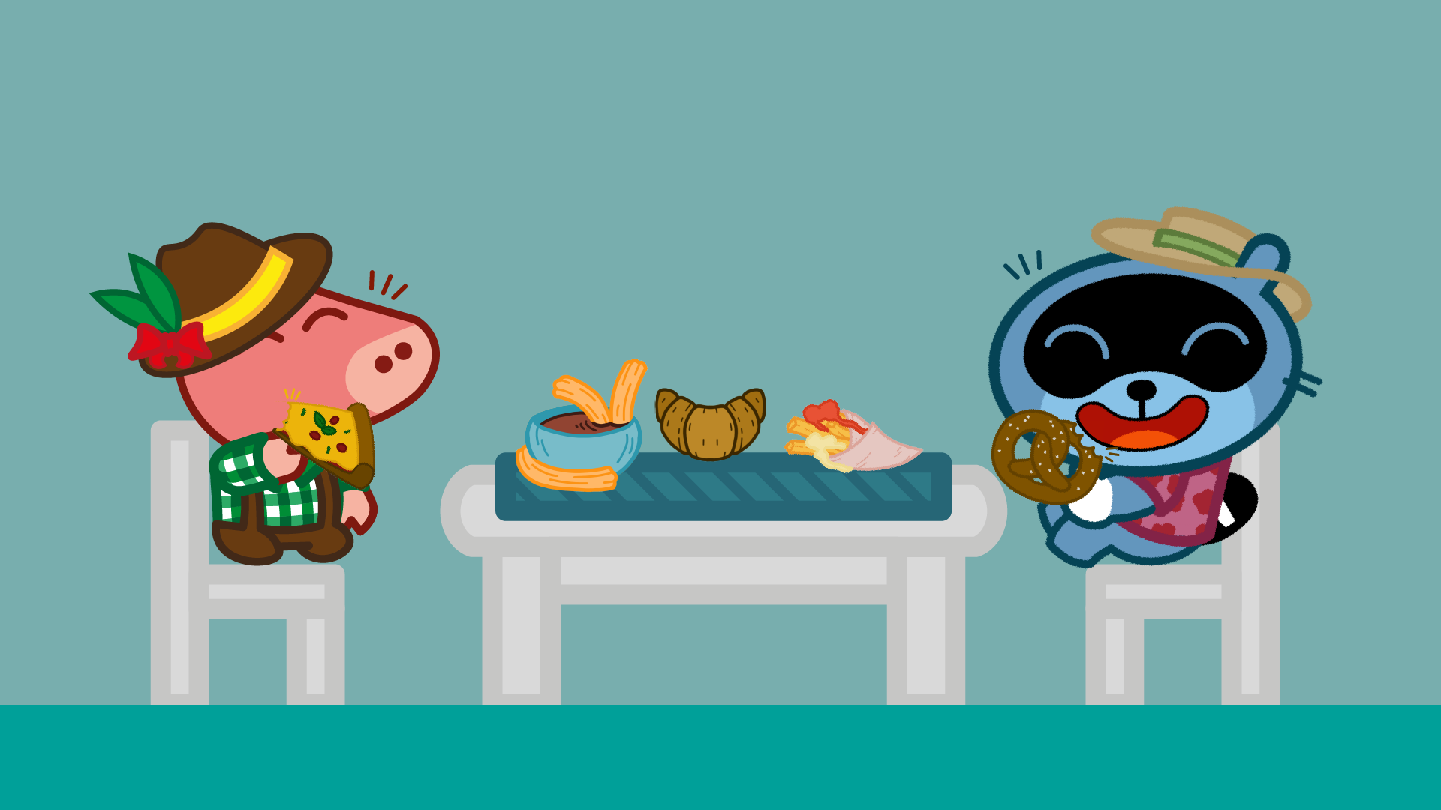



PIGGY
Piggy is just a happy little
pink pig.
We meet him in Europe!
Characters

Slide 7

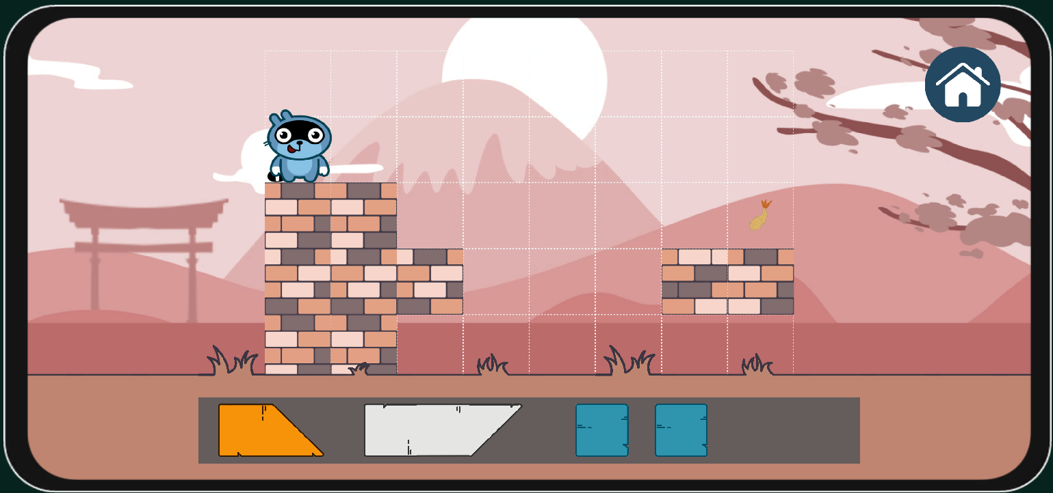
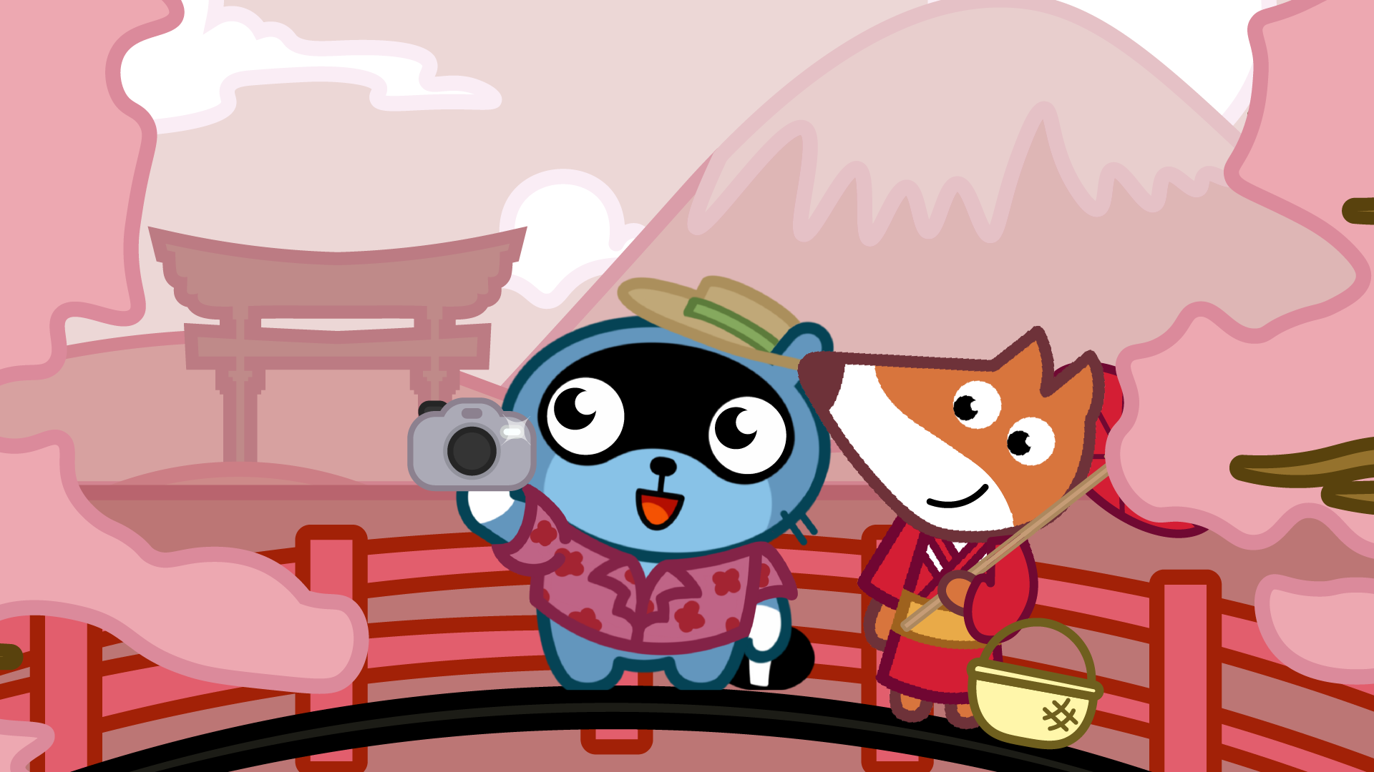



FOX
Fox is Pango’s Japanese friend and she wears the typical red kimono.
We meet her in Asia!
Characters

Slide 8

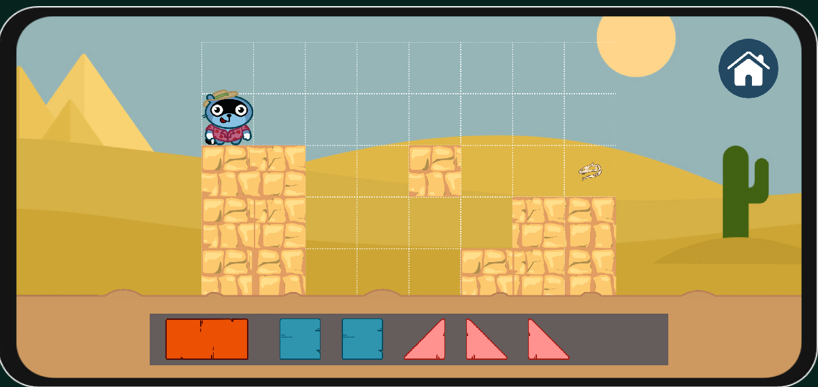

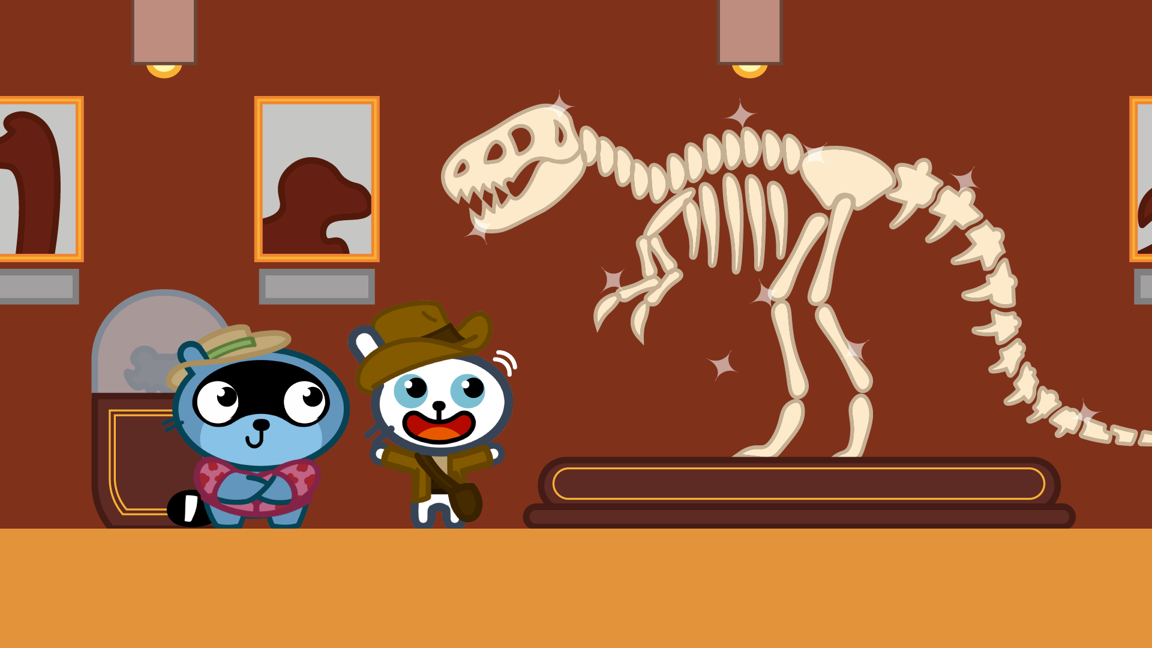


BUNNY
Bunny is Pango’s archaeologist friend who’s gathering resources to further his studies.
Bunny and Pango will meet in Africa!
Characters

Slide 9

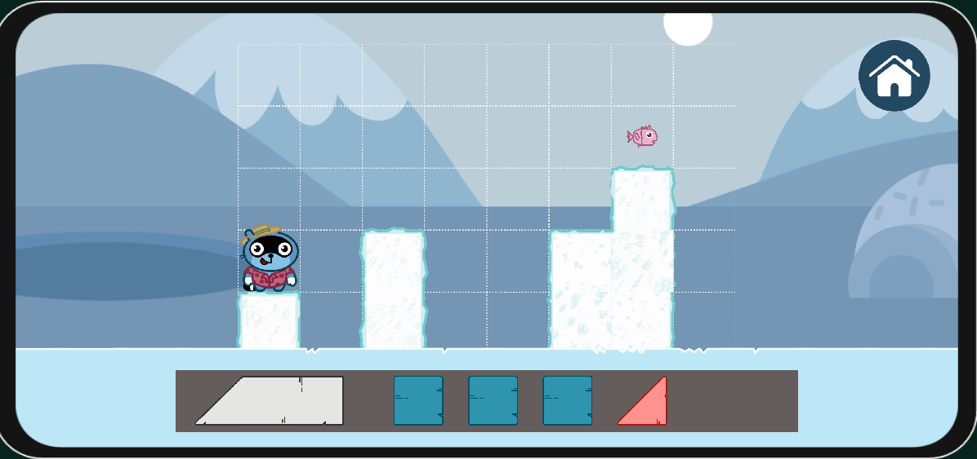





SQUIRREL
Squirrel invites Pango over to share a warm meal.
We meet him in the last part of Pango’s journey: Antarctica
Characters

Slide 10
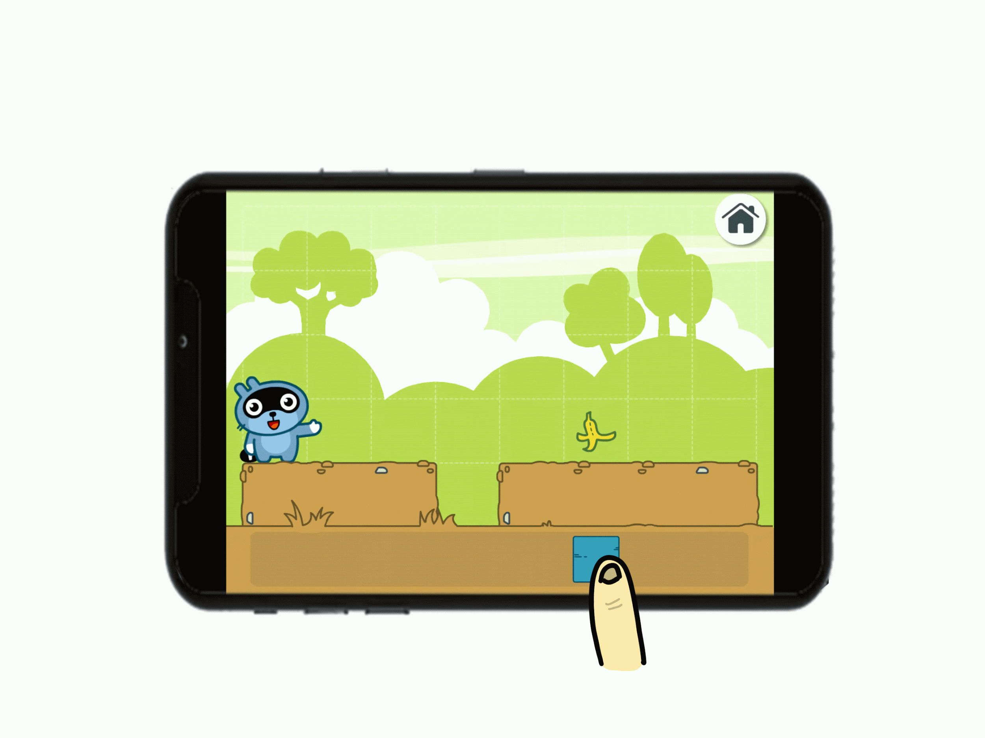
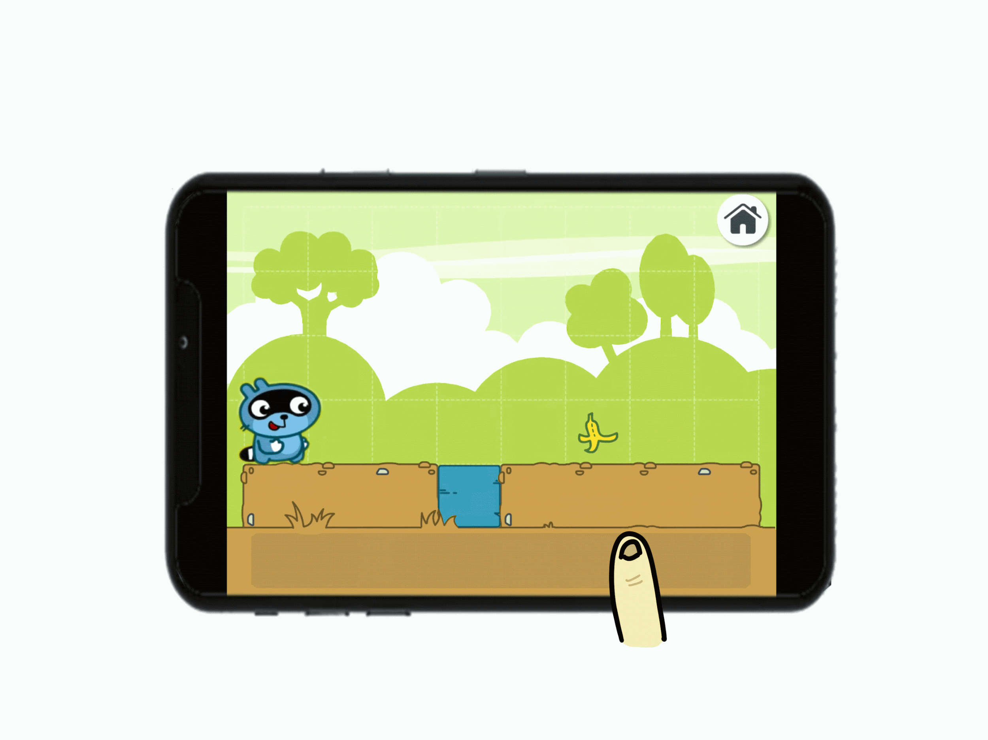

PLACEMENT BLOCKS
Place your blocks anywhere you want into the grid!
MOVEMENT
Create the best path for our friend Pango!
Core Mechanics

Slide 11

October 6 - October 13 - Pre production
October 13 - October 19 - Start Production
October 19 - October 26 - Low Fidelity Prototype
October 26 - November 2 - High Fidelity Prototype
November 2 - November 9 - Polishing and End Production
Road Map

Slide 12
THE TEAM
Game Designer
Cavallari Sharon
Guerra Valeria
Game Programming
Faraci Denis
Game Artist
Agosti Federico
Avanzi Nicole
Esposito Manuel
Gandini Sara
Pesce Letizia
Rizzo Paolo
Schiavi Marika
Timeo Giulia
Rindone Francesco
Contact us
theteam4@studio.com
Thank You!

